Slide 1
组合图
IELTS WRITING

Slide 2
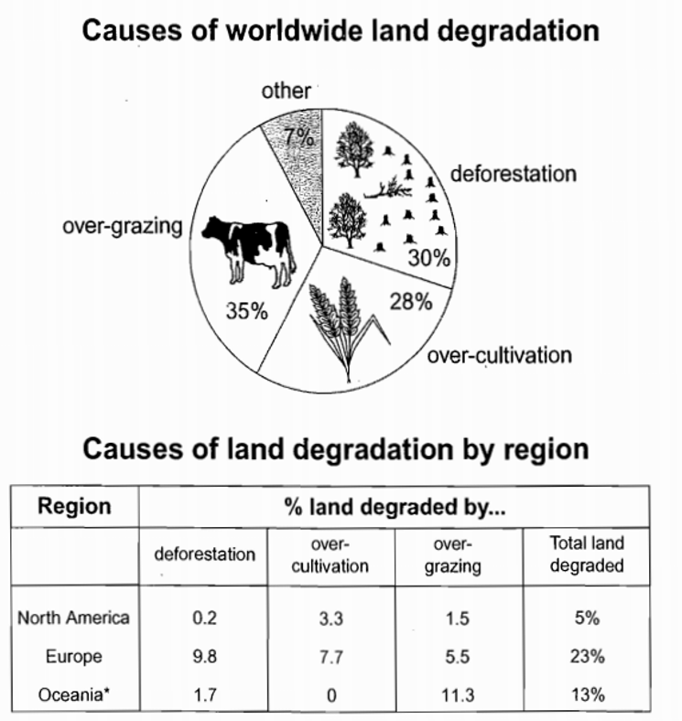
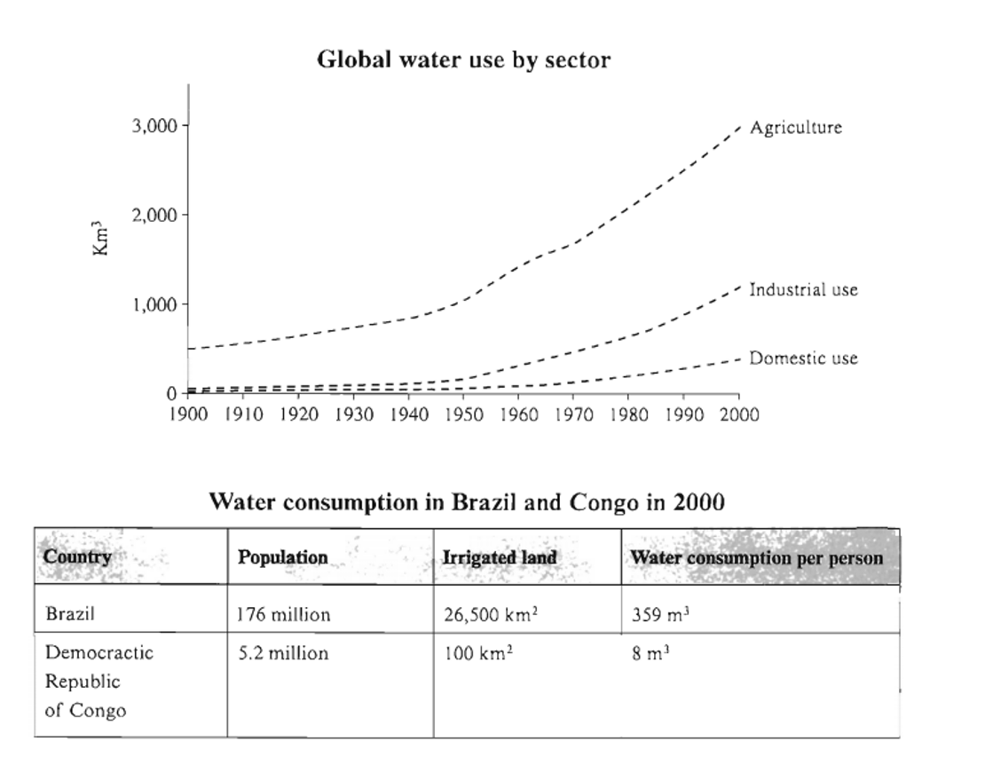
饼 + 表
线 + 表

Slide 3
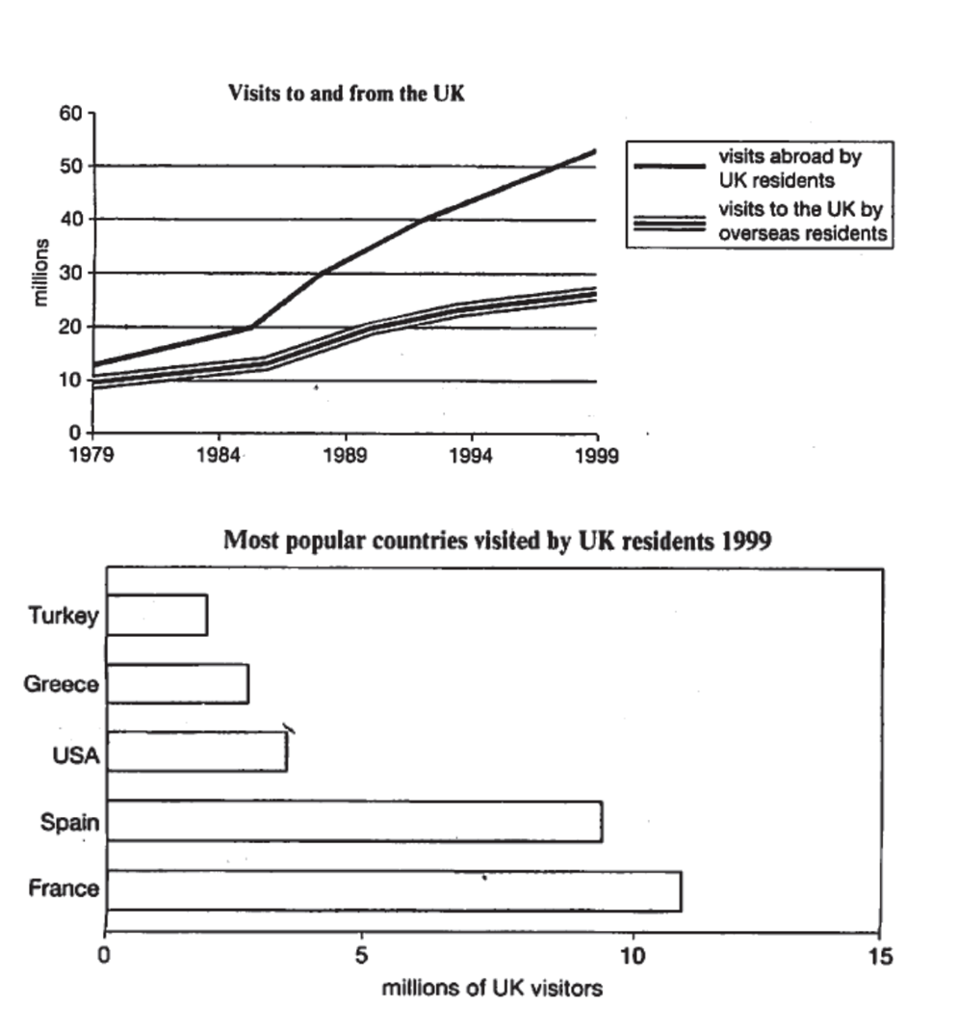
线 + 柱

Slide 4
IELTS WRITING LESSON 2
1. 组合图首段
2. 组合图主体段+范文分析
3. 组合图尾段
4. 课堂练习
5. 总结

Slide 5
IELTS WRITING
1. 组合图首段
2. 组合图主体段+范文分析
3. 组合图尾段
4. 课堂练习
5. 总结

Slide 6
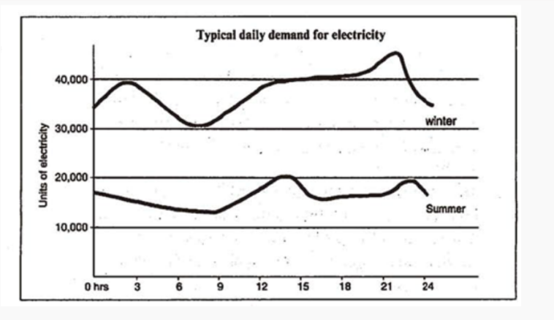
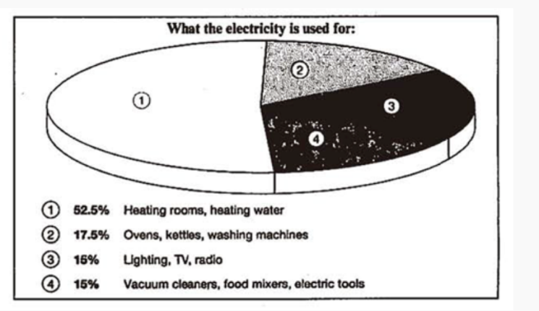
1. 组合图首段
C4T2
The graph below shows the demand for electricity in England during typical days in winter and summer. The pie chart shows how electricity is used in an average English home.
图A shows …, and / while图B describes….
(图A和图B为同一类型图表时，则The charts/graphs indicate...and...)
The given line graph illustrates the typical daily demand for electricity in winter and summer days, while the pie chart presents the distribution of electricity used for different purposes in an average English household.

Slide 7
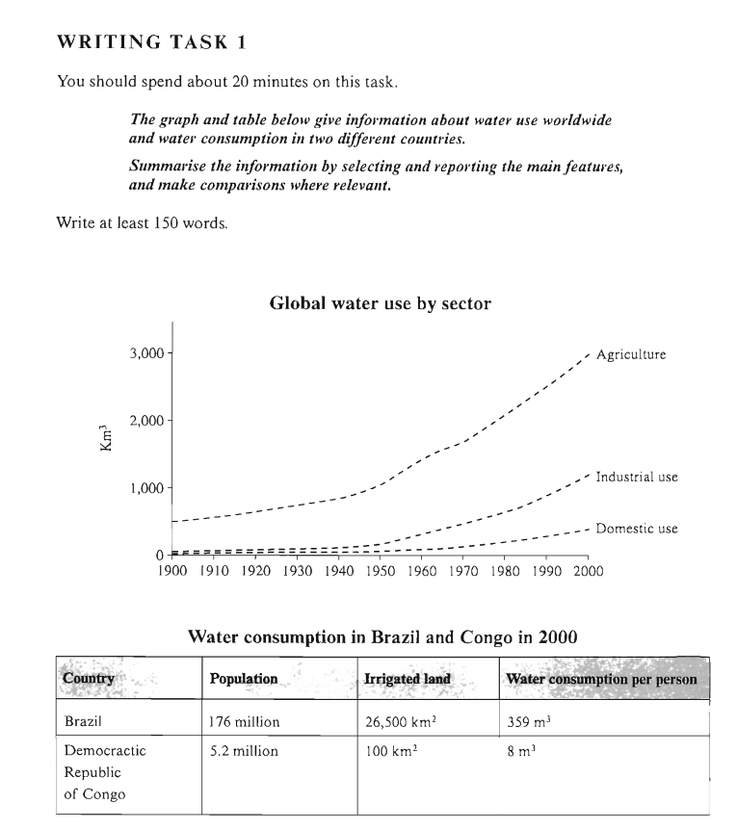
组合图首段写作练习
C6T1
The line graph describes how global water was used between 1990 and 2000, while the table compares the water consumption in two different countries – Brazil and Congo.

Slide 9
The diagram illustrates how global water was used and the sheet shows/compares two countries’ quantity of water consumed.

Slide 10
IELTS WRITING LESSON 2
1. 组合图首段
2. 组合图主体段+范文分析
3. 组合图尾段
4. 课堂练习
5. 总结

Slide 11
C6T1
2. 组合图主体段
组合图
动态图(线)+静态图(表)
一图一段
Notes:
范文：C6T1 model answer

Slide 12
组合图段落结构
总分结构
段落 | 句数 | 方式
开头段 | 1-2句 | 改写题目
主体段1 | x句 | 一图一段 x为具体数据描写 （挑选重点特征概括，不要流水账式描述）
……
主体段n

Slide 13
2. 组合图主体段
句型
由图可见，描述总体趋势
According to the pie chart, …
As shown in the table, …
It can be seen from the line graph that …
具体来说，具体信息描述
To be more specific, … = more specifically
To be more exact, … = more exactly

Slide 14
2. 组合图主体段
衔接词
【之后】from then on, from that time onwards, after that, next, afterwards
2) 【转折】however/ by contrast
3) 【对比】while/ whilst
4) 【类比】similarly / likewise

Slide 15
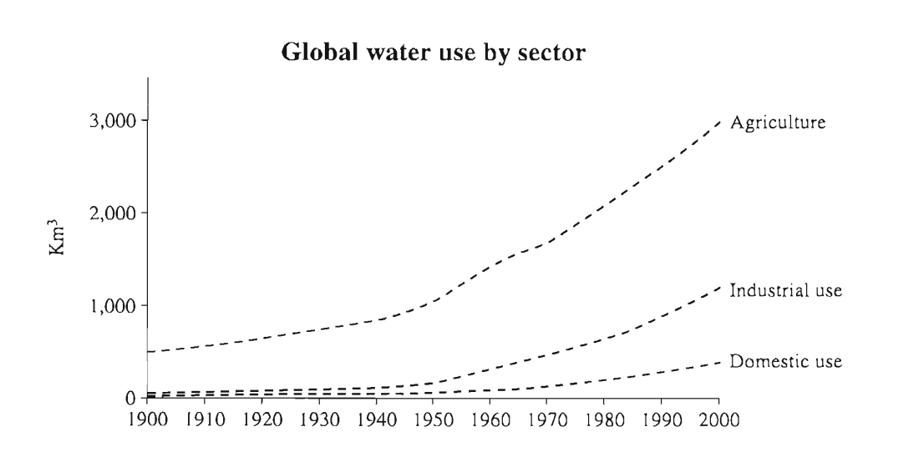
动态图
TA
the largest quantity
increased dramatically
both far below the levels of consumption by agriculture.
rose more slowly
grew steadily

Slide 16
动态图
body paragraph 1
Throughout the century, the largest quantity of water was used for agricultural purposes, and this increased dramatically from about 500 km³ to around 3,000 km³ in the year 2000. Water used in the industrial and domestic sectors also increased, but consumption was minimal until mid-century. From 1950 onwards, industrial use grew steadily to just over 1,000 km³, while domestic use rose more slowly to only 300 km³, both far below the levels of consumption by agriculture.

Slide 17
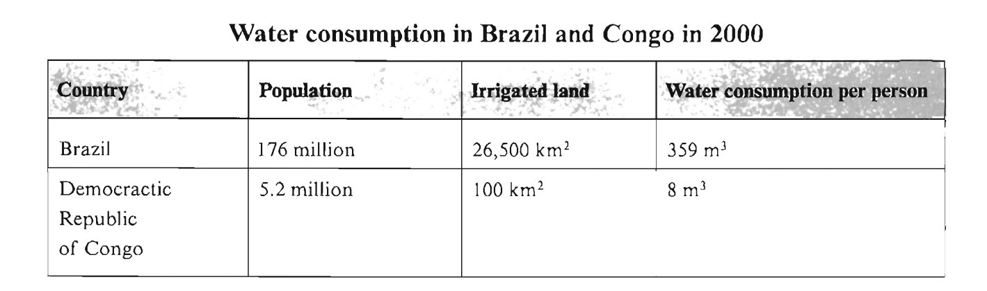
静态图
TA
挑选数据
body paragraph 2
The table illustrates the differences in agricultural consumption in some areas of the world by contrasting the amount of irrigated land in Brazil (26,500 km²) with that in the D.R.C. (100 km²). This means that a huge amount of water is used in agriculture in Brazil, which is reflected in the figures for water consumption per person: 359 m³ compared with only 8 m³ in the Congo. With a population of 176 million, the figures for Brazil indicate how high agricultural water consumption can be in some countries.

Slide 18
IELTS WRITING
1. 组合图首段
2. 组合图主体段+范文分析
3. 组合图尾段
4. 课堂练习
5. 总结

Slide 19
组合图段落结构
总分总结构
段落 | 句数 | 方式
开头段 | 1-2句 | 改写题目
主体段1 | x句 | x为具体数据描写 （挑选重点特征概括，不要流水账式描述）
……
主体段n
结尾段 | 1-2句 | 综合对比各个图特征

Slide 20
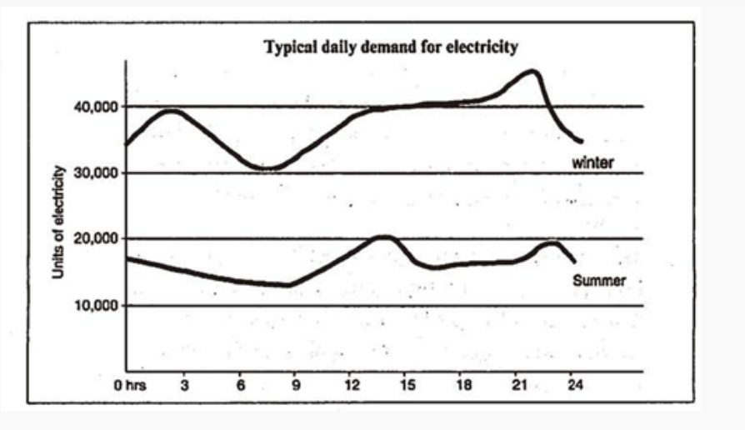

3. 组合图尾段
总结主要特征
C4T2
To sum up, the electricity used for heating leads to much more electricity consumption in winter days than in summer.

Slide 21
IELTS WRITING LESSON 2
1. 组合图首段
2. 组合图主体段+范文分析
3. 组合图尾段
4. 课堂练习
5. 总结

Slide 22
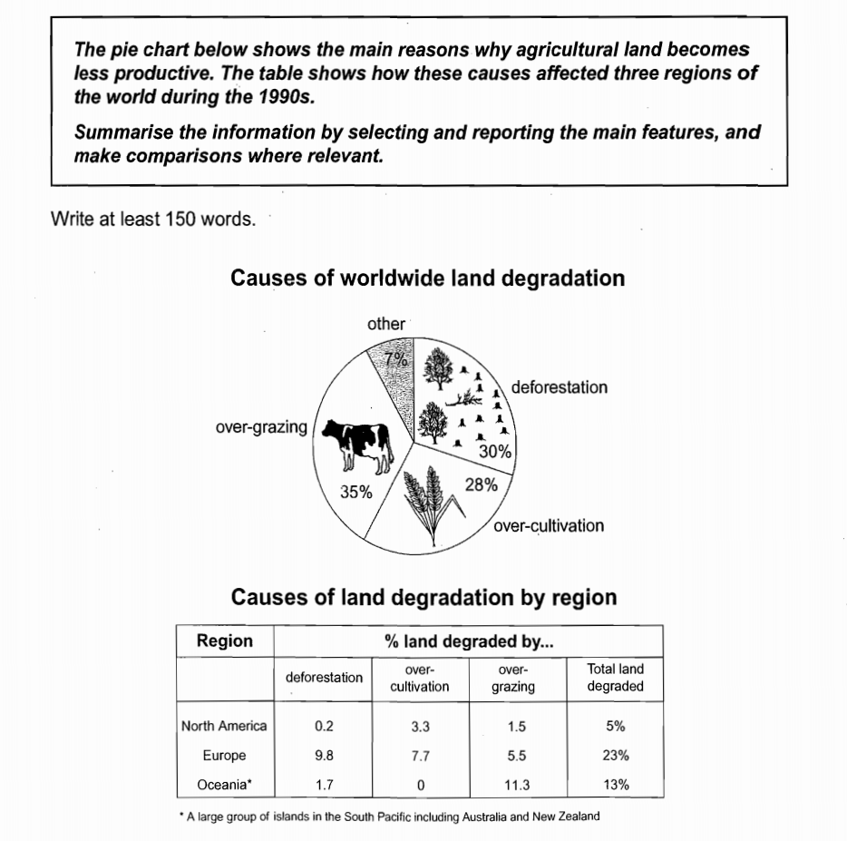
4. 课堂练习
练习1 ：C8T1
组合图
静态图(饼+表)
一图一段
Notes:
范文： C8T1 model answer

Slide 24
According to the pie chart, over-grazing leads to the biggest part of land degradation which accounts for 35 percent of worldwide land degradation. From then on, in terms of deforestation and over-cultivation, both make up similar percentage/proportion of land degraded with 30% and 28% respectively. are parallel. The others make up/constitute the least part of the chart land degradation, which only comprise seven percent of the land degradation.

Slide 25
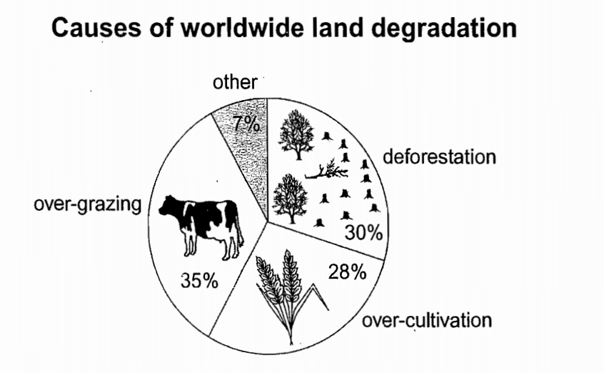
正文 1
第一大和第二大数据
第三
最小数据
The pie chart shows that there are four main causes of farmland becoming degraded in the world today. Globally, 65% of degradation is caused by too much animal grazing and tree clearance, constituting 35% and 30% respectively. A further 28% of global degradation is due to over-cultivation of crops. Other causes account for only 7% collectively.

Slide 26
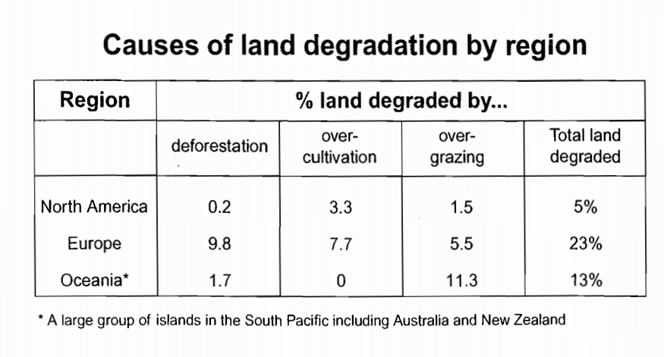
正文 2
Europe
Oceania
North America
These causes affected different regions differently in the 1990s, with Europe having as much as 9.8% of degradation due to deforestation, while the impact of this on Oceania and North America was minimal, with only 1.7% and 0.2% of land affected respectively. Europe, with the highest overall percentage of land degraded (23%), also suffered from over-cultivation (7.7%) and over-grazing (5.5%). In contrast, Oceania had 13% of degraded farmland and this was mainly due to over-grazing (11.3%). North America had a lower proportion of degraded land at only 5%, and the main causes of this were over-cultivation (3.3%) and, to a lesser extent, over-grazing (1.5%).

Slide 27
尾段
Overall, it is clear that Europe suffer more farmland degradation than the other regions, and the main causes there were deforestation and overcultivation

Slide 28
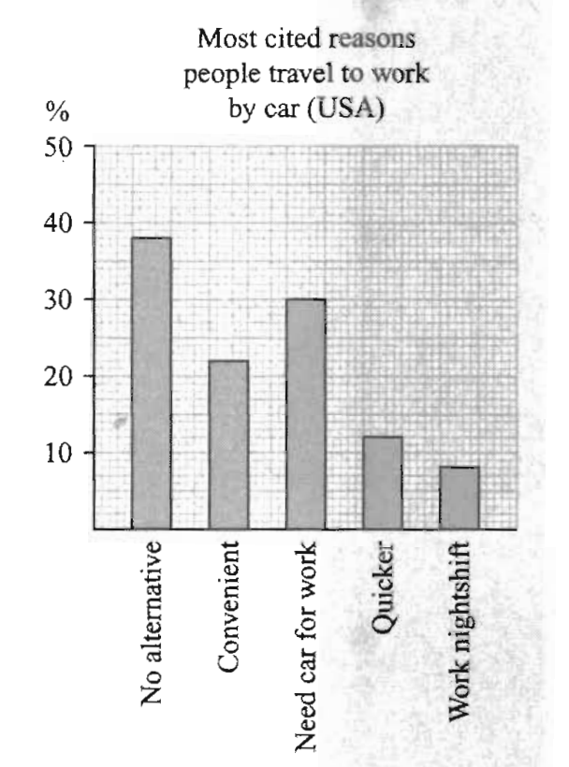
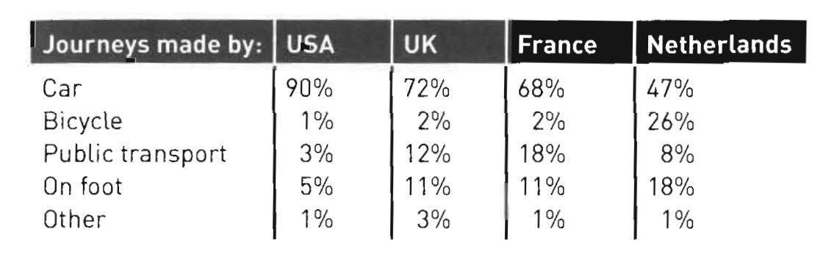
4. 课堂练习
练习2: 胡敏雅思7代
The table shows the percentage of journeys made by different forms of transport in four countries. The bar chart shows the results of a survey into car use.
首段
The table compares four countries in terms of the proportion of journeys undertaken by five modes of travel. The bar chart gives findings of a study into the reasons people in the USA drive.

Slide 30
Most US people drove to work by car/commuted by car because they had no alternatives/other choices, with around 38%. Together, a bigger group of people travelled by car for work due to convenience and necessity, accounting for over a half. In contrast, much lower percentage of people thought it was quicker to work by car/considered cars as quicker travelling tools, with only 8% of people travelling by car for working nightshift.

Slide 31
正文 1
As can be seen from the table, cars were the most freguently used form of transport in all four countries. However, the proportion of journeys made by car ranged from a low of 47% in the Netherlands to a high of 90% in the USA. Figures for the other forms of transport also varied considerably. Not surprisingly, in the Netherlands, a high proportion of trips were made by bicycle (26%) and on foot (18%). The highest rate of public transport use was in France, where nearly one in five journeys was made by public transport.

Slide 32
正文 2
The bar chart provides information that mav helo explain why car use is so high in the USA. The most cited reason was lack of any other alternative (38%). Although a sizable percentage of people said it was more convenient (21%), the other factors listed related more to need than preference, e.g. working night shift.

Slide 33
尾段
Overall, the figures show how considerable variation in modes of transport used, though the car continued to dominate in most contexts.

Slide 34
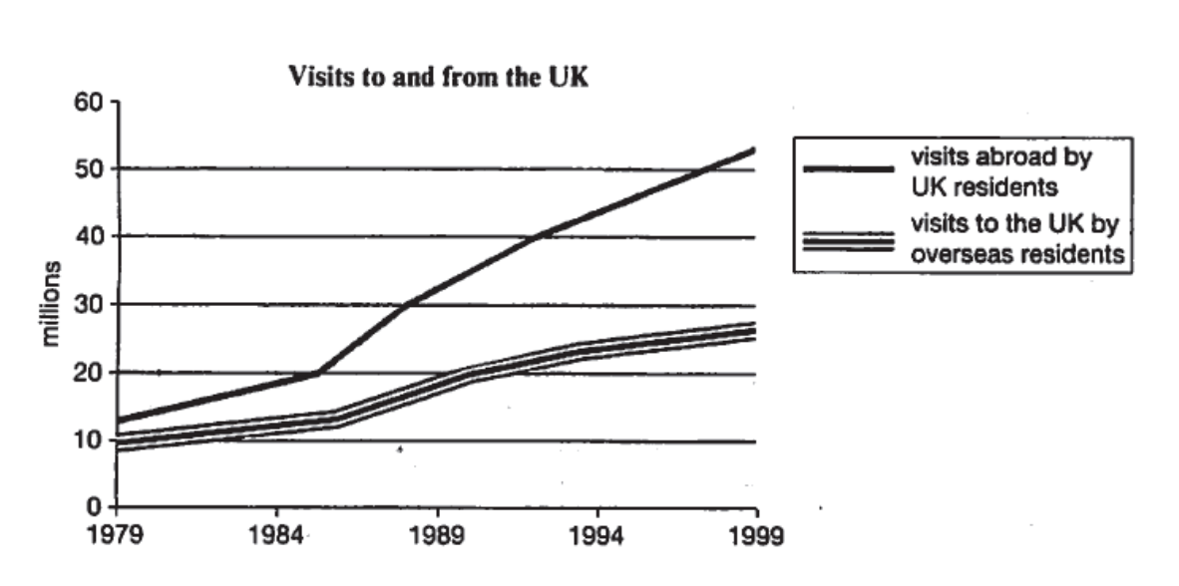
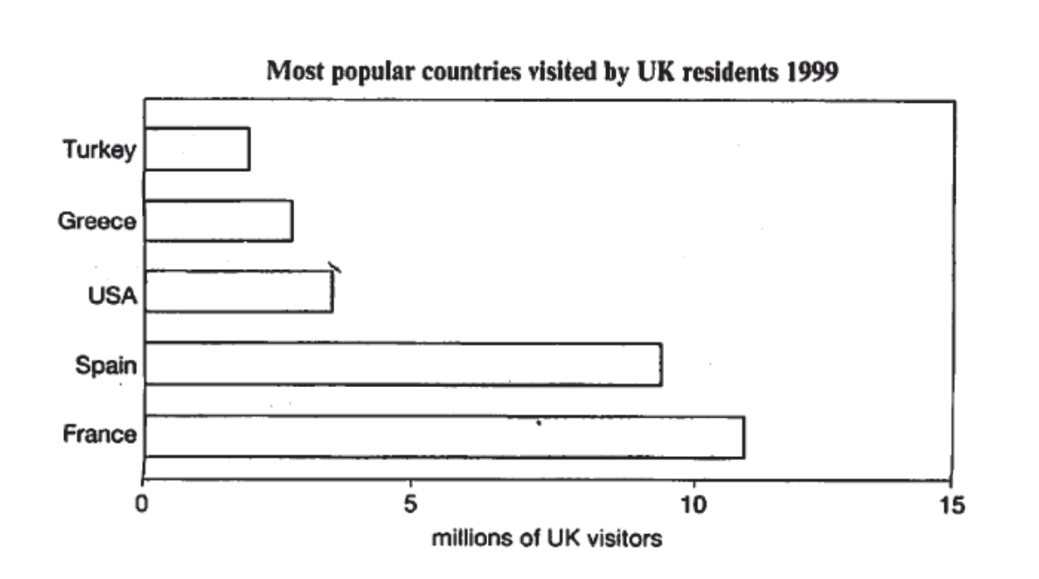
Homework
C4T4
The charts below give information about travel to and from the UK, and about the most popular countries for UK residents to visit.

Slide 35
参考范文
The line graph illustrates the changes in the visits to and from the UK, and the bar chart compares the travel destinations which enjoyed the greatest popularity among UK visitors in 1999.
The number of UK travelers was higher than that of overseas residents visiting UK during the whole period, rising from approximately 13 million in 1979 to 54 million in 1999. The growth was particularly noticeable from 1985 to 1999, during which time the figure for UK visitors more than doubled. Likewise, the figure for overseas travelers visiting UK experienced an upward trend from 10 million in 1979 to 12 million in 1986, followed by a more significant growth to 26 million at the end of the period in question.
As can be seen from the bar chart, there were five countries which attracted most UK travelers, namely Turkey, Greece, USA, Spain and France. Specifically, France was the most popular, with nearly 12 million UK residents visiting there. Spain ranked second, and the number of UK visitors who went there was almost 9 million. By contrast, USA, Greece and Turkey seemed less popular, with the figure 2 to 4 million on average less than half of that of France and Spain.
Overall, it is clear that visits to and from the UK increased over the two decades, and France was highly favoured by UK travelers.
Notes:
C4T4范文：小作文范文集

Slide 36
雅思写作考前准备
纸笔考试
写作考试：笔试第3部分，耗时1小时（开始于大约11:15，结束于大约12:15）
1张试卷，2张答题纸（task1、task2各一张，若不够可申请加纸）
铅笔答题（铅笔、橡皮由考场提供）

Slide 37
雅思写作考前准备
机考
写作考试：机考第3部分，耗时1小时
个人信息纸（含写作机考password）、铅笔（无橡皮）
题目在屏幕左边，答题区域在屏幕右边
小作文和大作文可随时切换（系统自动保存已完成的内容）
可复制粘贴；系统自动统计字数（无拼写检查功能）
可调整文字大小、颜色及分辨率

Slide 38
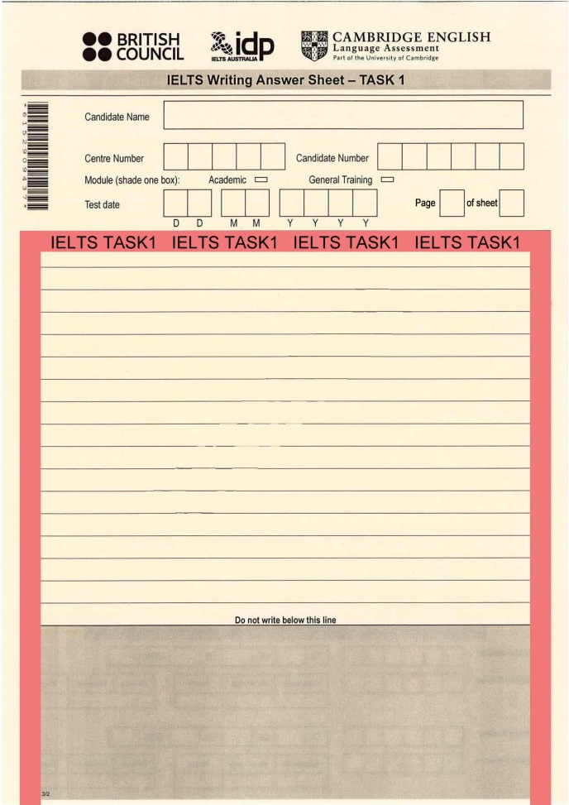
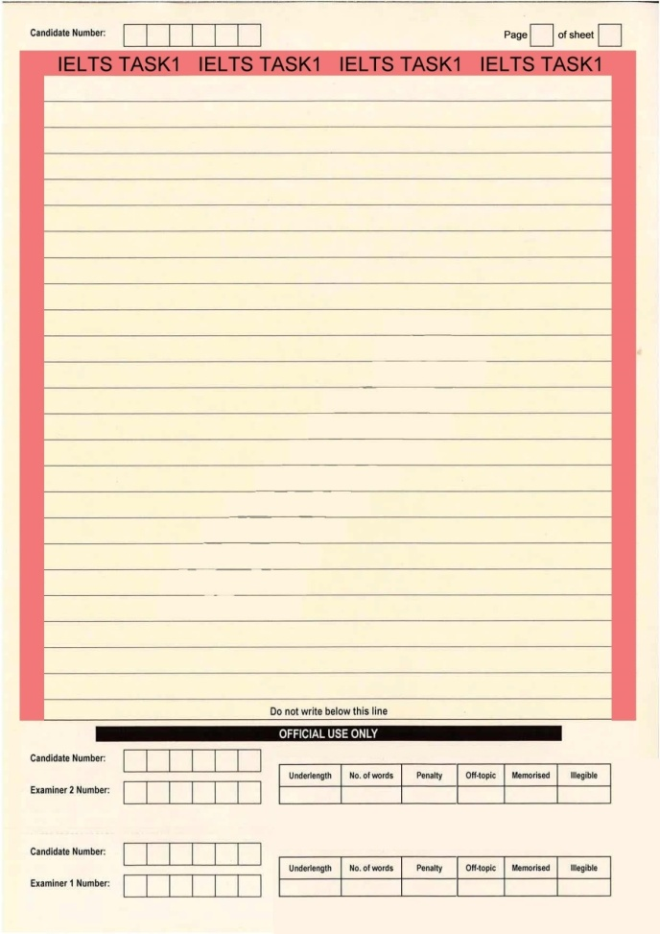
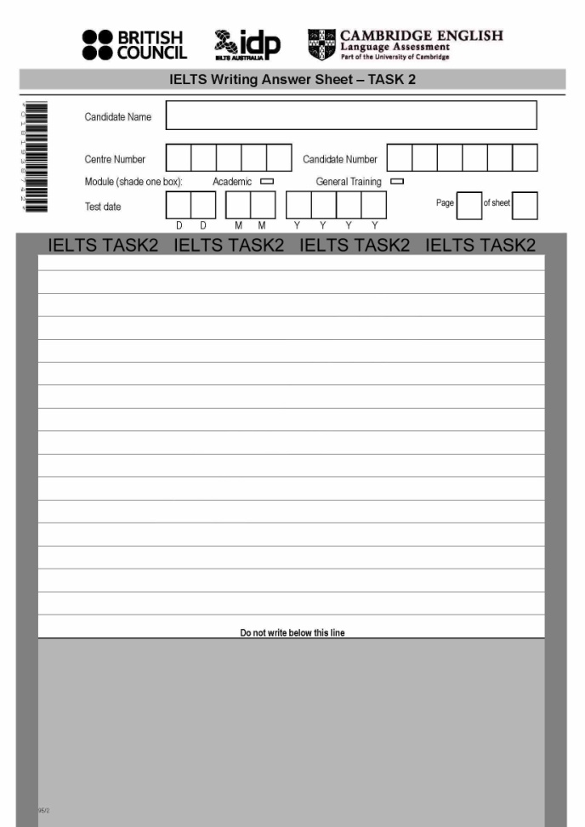
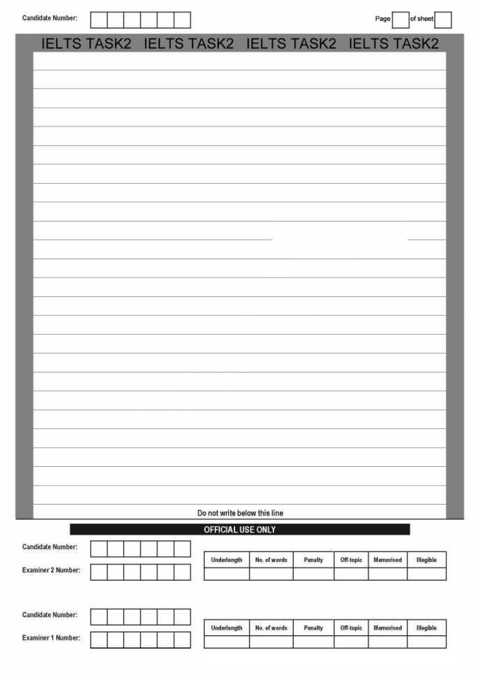
TASK1 ANSWER SHEET
TASK2 ANSWER SHEET

Slide 39
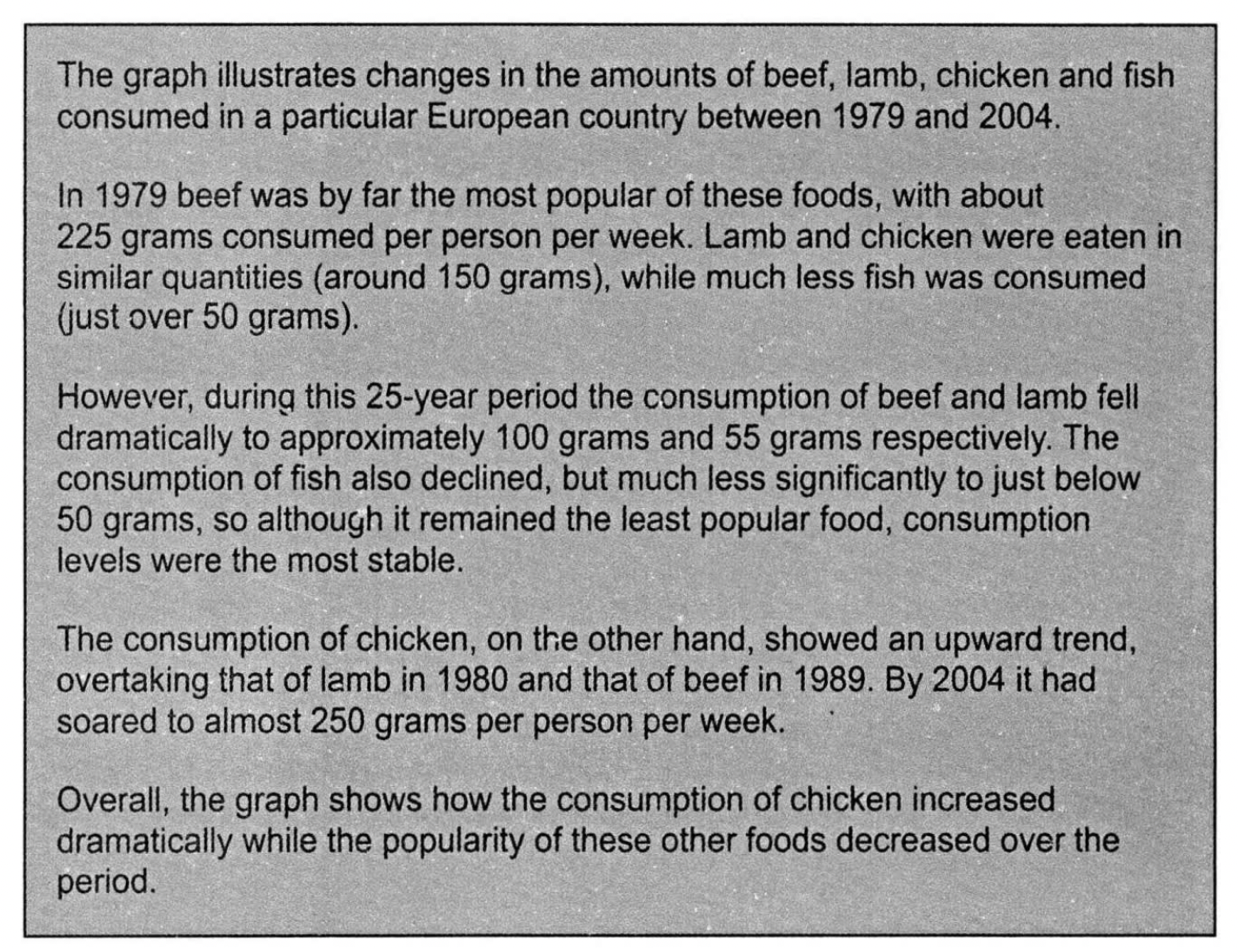
Task1小作文
格式要求：
段间空行
齐头书写
避免缩写
篇幅平衡
C7T2考官范文

Slide 40
Task1小作文
Task1小作文评分标准
(band 7)
写作内容涵盖写作任务的要求
清晰地呈现关于主要趋势、区别或不同阶段的概述
能就主要内容/要点进行清晰的呈现与强调，但未能更为充分地展开
Task Achievement
写作任务完成情况
Coherence & Cohesion
连贯与衔接
Lexical Resource
词汇丰富程度
Grammatical Range & Accuracy
语法多样性及准确性

Slide 41
Task1小作文
Task1小作文评分标准
Task Achievement
写作任务完成情况
Coherence & Cohesion
连贯与衔接
Lexical Resource
词汇丰富程度
Grammatical Range & Accuracy
语法多样性及准确性
(band 7)
符合逻辑地组织信息及观点；清晰的行文推进贯穿全文
恰当地使用一系列衔接手段，尽管有时使用不足或过多

Slide 42
Task1小作文
Task1小作文评分标准
Task Achievement
写作任务完成情况
Coherence & Cohesion
连贯与衔接
Lexical Resource
词汇丰富程度
Grammatical Range & Accuracy
语法多样性及准确性
(band 7)
使用足够的词汇，体现一定灵活性及准确性
使用不常见词汇，对语体及搭配有一定认识
在选择用词、拼写及/或构词方面可能偶尔出现错误

Slide 43
Task1小作文
Task1小作文评分标准
Task Achievement
写作任务完成情况
Coherence & Cohesion
连贯与衔接
Lexical Resource
词汇丰富程度
Grammatical Range & Accuracy
语法多样性及准确性
(band 7)
运用各种复杂的语法结构
多数句子准确无误
对语法及标点符号掌握较好，但有时出现少许错误

